Slide 1


Serverless Computing
A division of Vinsys IT Services (I) Pvt. Ltd.
Ideals induced, imbibed and implemented!

Slide 2
What’s Serverless?
Serverless is a new paradigm in which the developers do not have to manage servers.
They just deploy code.
They just deploy…functions!
Initially… Serverless == FaaS (Function as a Service)
Serverless by Pioneered by AWS Lambda but now also includes everything else that’s managed (databases, messaging, storage etc.)

Slide 3

The Emergence of Serverless
Early Cloud Computing
Start of Cloud Computing in the early 2000’s
AWS, Azure and Google Cloud Launch IaaS and PaaS

Slide 4
The Rise of Event-Driven Programming
Building applications that respond to events:
HTTP Requests
Database changes
Messages from Queues
Changes in File Storage
Development of Event Driven Architectures

Slide 5

AWS Lambda
Launch of AWS Lambda in 2014
Allowed Developers to execute code in response to events
Marked the beginning of the FaaS Paradigm

Slide 6

Popularity and Growth
AWS Lambda’s success inspired Microsoft Azure Functions in 2016 and Google’s Cloud Functions in 2018.
Providing Similar Capabilities

Slide 7

Serverless Orchestration and Beyond
Expansion beyond FaaS offerings
AWS Step Functions for Workflows
AWS App Runner for Containerized Serverless Applications

Slide 8
Few Use Cases for Serverless Computing
Web Application and APIs
Data Processing and ETL
Real-time File and Data Stream Processing
IoT Applications
Image and Video Processing
Chatbots and NLP
Scheduled Tasks and CRON Jobs
Backend for Mobile Applications

Slide 9
Serverless Computing in Banking
Customer Facing Applications
Security and Compliance
Data Processing and Analytics
Notification and Alerts
Backend Services
Batch Processing and Report Generation
Compliance Reporting

Slide 10
Where Serverless is not suitable
Long Running or Continuous Workloads
High -Performance Computing
Stateful Applications
Large File Processing
Legacy Systems
Highly Predictable Workloads
Network-Intensive Workloads
Latency-Sensitive Real-Time Systems
Regulatory and Compliance Systems

Slide 11
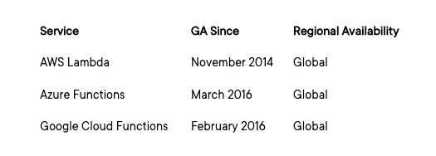
FaaS Service Providers

Slide 12
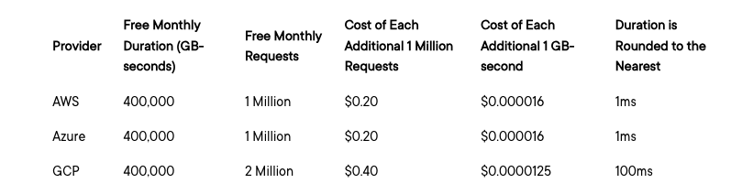
Pricing for Serverless
Number of Requests
Compute Time

Slide 13

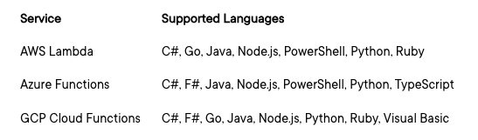
Language Support
Recommended Languages
Python
C#
Node.js
Java

Slide 14
Scalability
All three providers virtually unlimited and automatic scaling.
Event is Received
Instance of the Function is spun up.
Request is Processed
Instance is kept alive to Process Subsequent events.
If None are received, it is recycled.

Slide 15

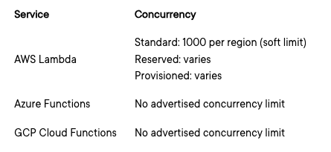
Concurrency
Number of simultaneous functions that can run at a time.

Slide 16

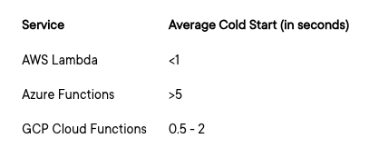
Cold Starts
FaaS instance in an inactive state will take additional time to respond.
Can affect the performance of FaaS workloads that are very sensitive to delay.

Slide 17

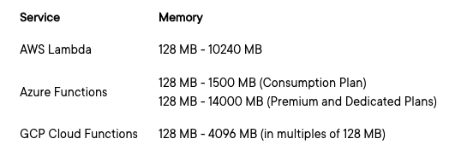
Memory

Slide 18

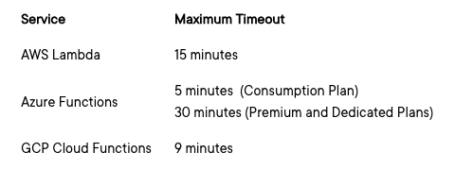
Execution Time

Slide 19

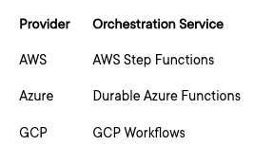
Orchestration
Stateless as Stateful
Integrating functions as steps in a Workflow
Enabling complex application in serverless approach

Slide 20

Thank You!!
www.vinsys.com
enquiry@vinsys.com

Slide 21
Serverless Computing

